Slide 1
Final Task Skyview Swiper App Final Version
By: Thomas Hoerger – Solo Group 9

Slide 2
Step 1 Setup VPS and MySQL Database
• Deployed Ubuntu server on Google Cloud VPS.
• Installed Apache, PHP, and MySQL.

Slide 3
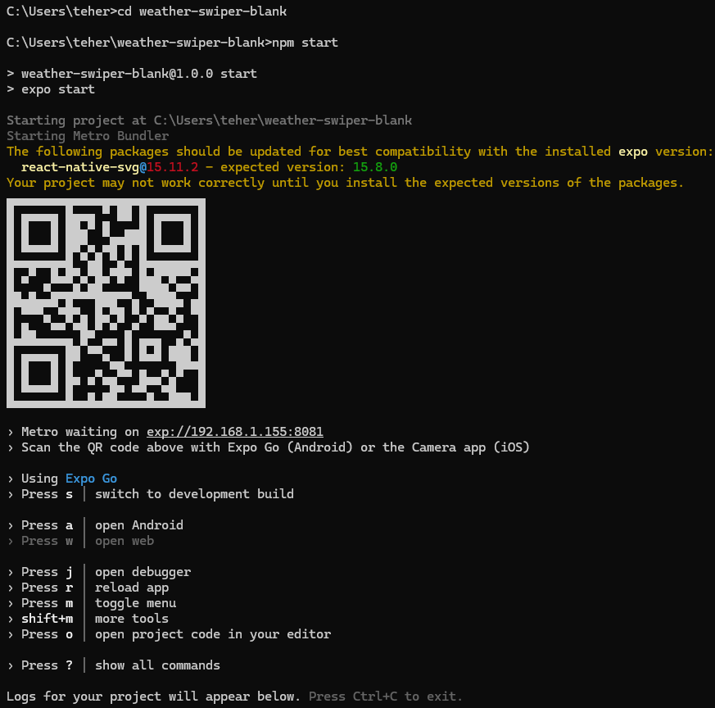

Step 2 Created Expo project with npx create-expo-app weather-swiper-blank after installing it on the local system

Slide 4
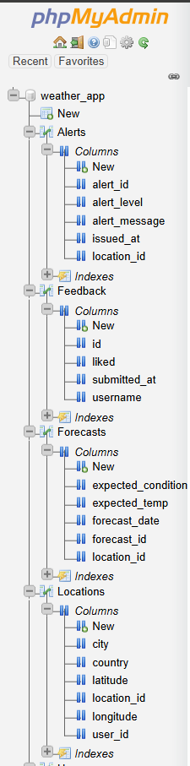
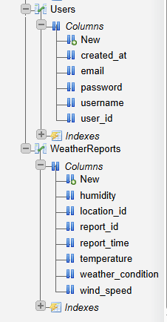
Step 3 Created a MySQL database weather_app with 6 tables: Users, Locations, WeatherReports, Forecasts, Alerts, and Feedback.

Slide 5
Step 4 Created and enabled remote access to the following PHP scripts on VPS:

Slide 6
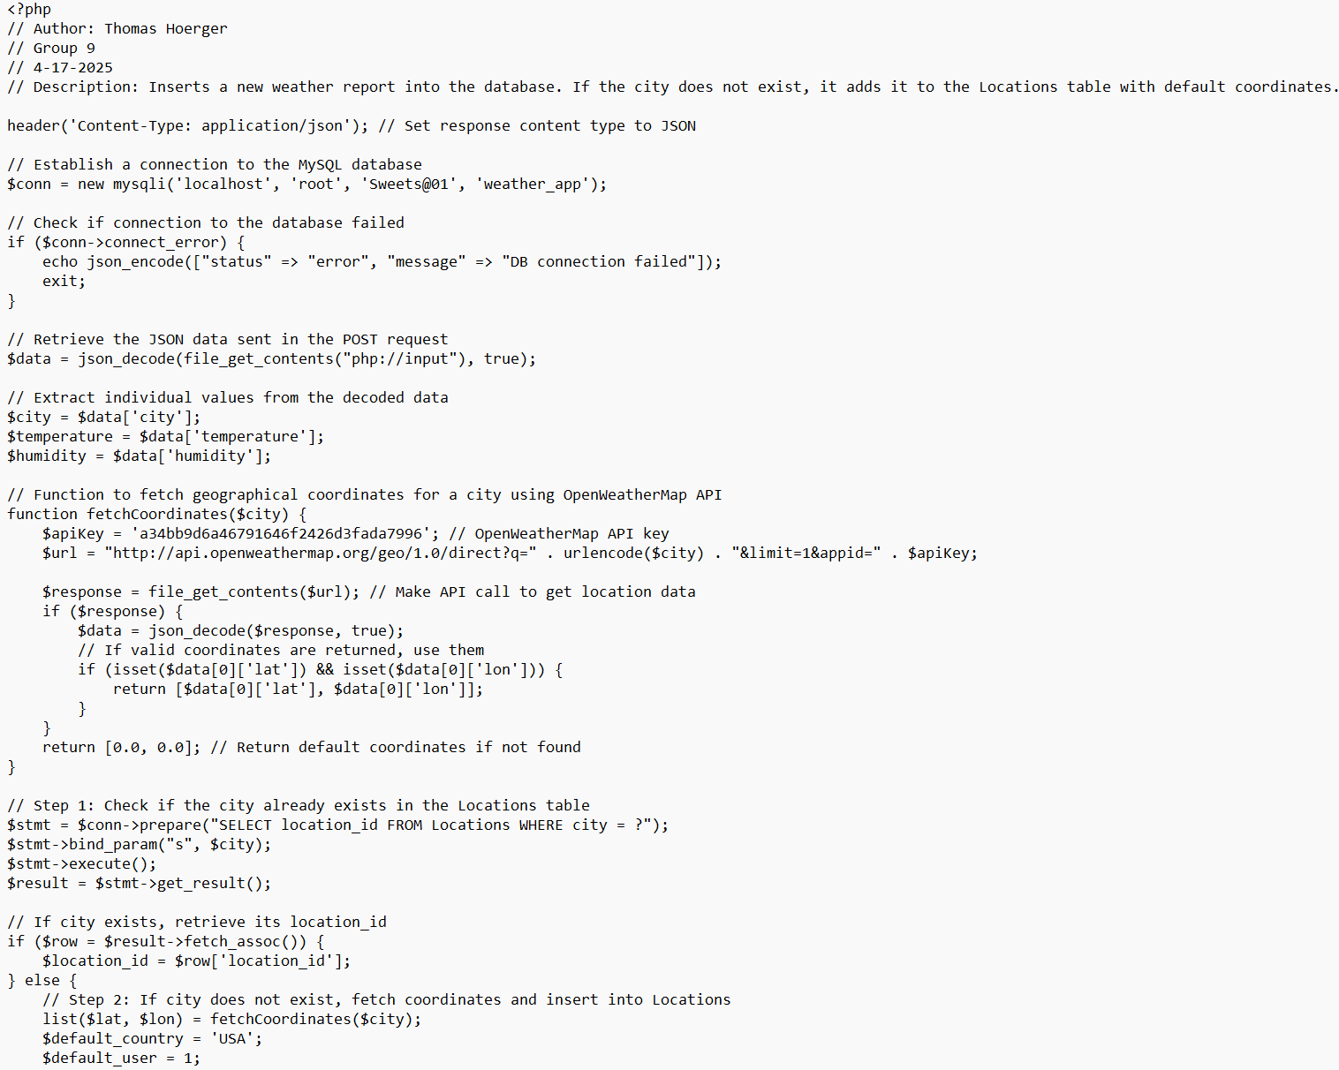
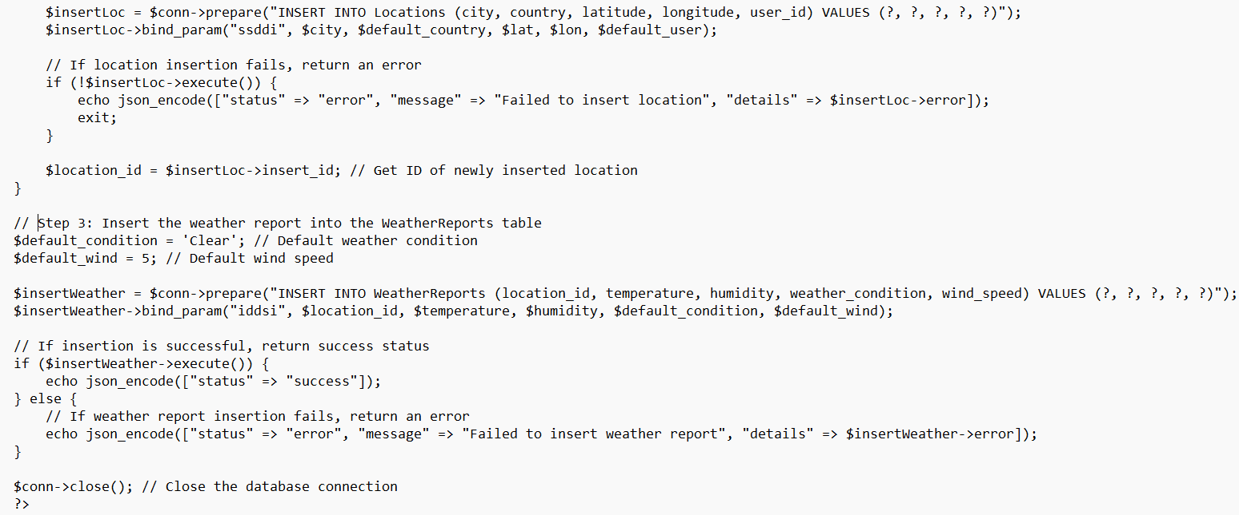
add_weather.php: Adds data to the database.

Slide 7
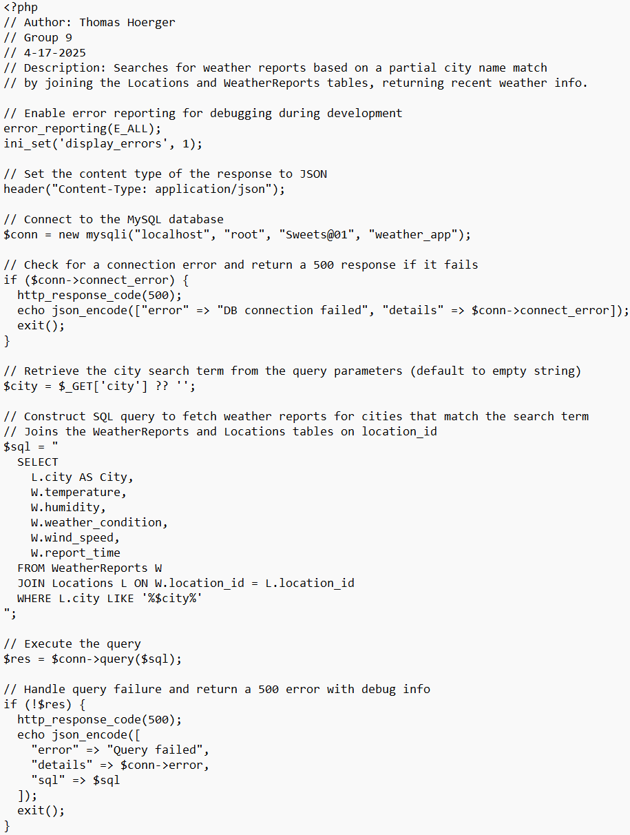
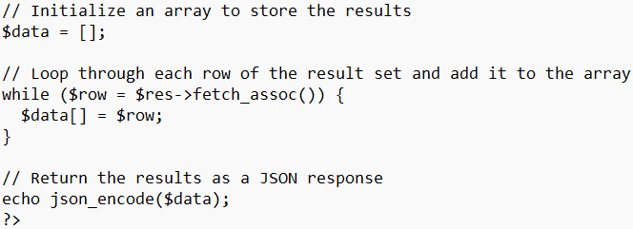
search_weather.php: Retrieves weather by city.

Slide 8
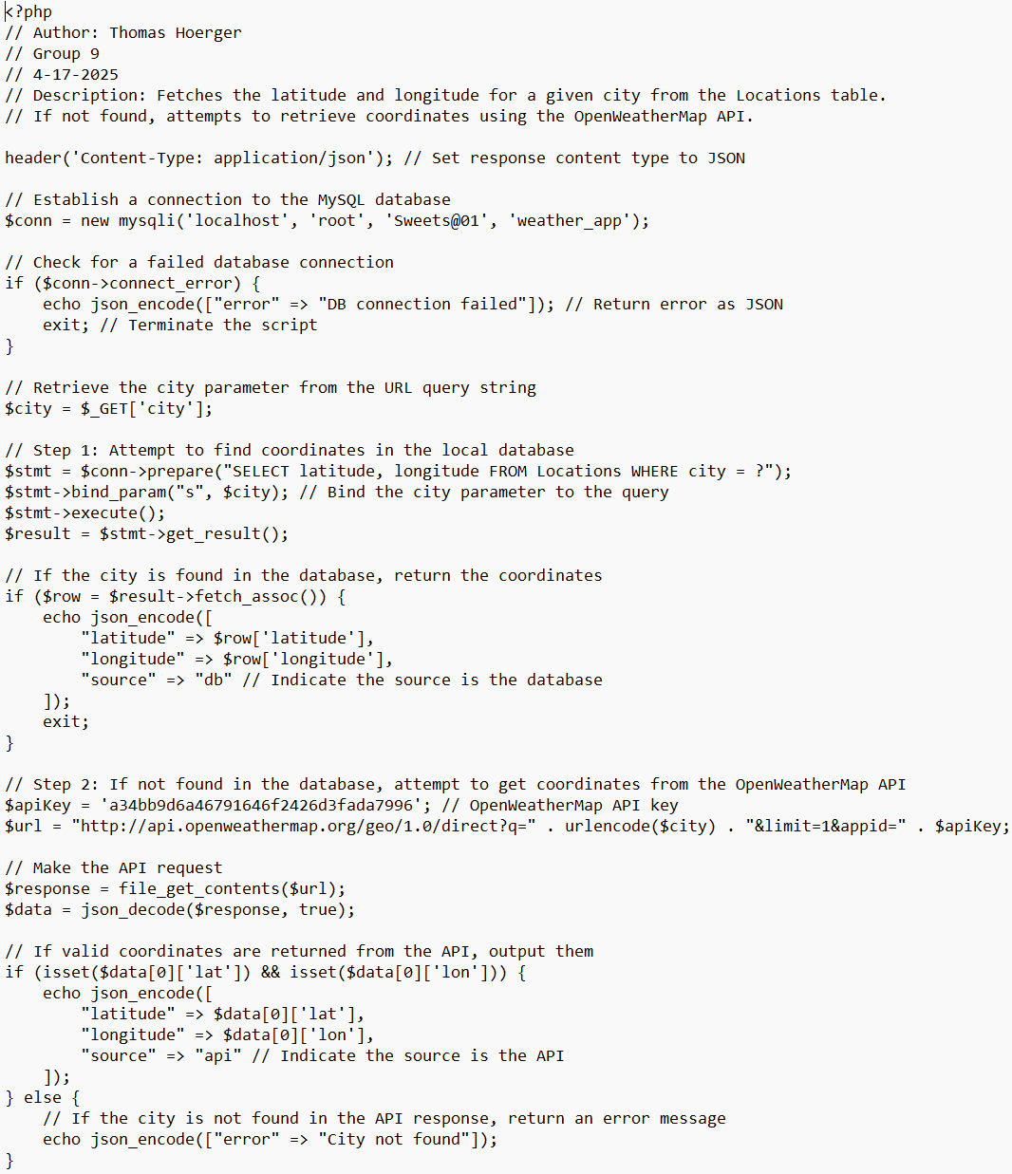
get_coords.php: Zooms map to entered city location (with fallback to OpenWeatherMap).

Slide 9
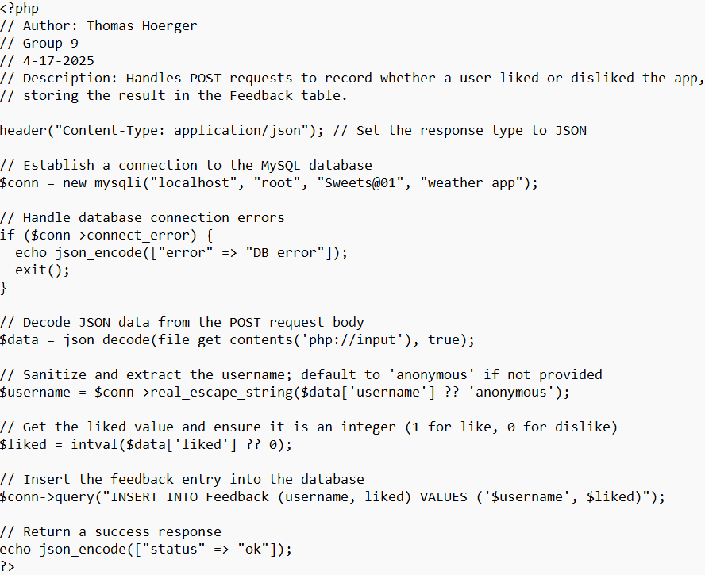
submit_feedback.php: Stores like/dislike values.

Slide 10
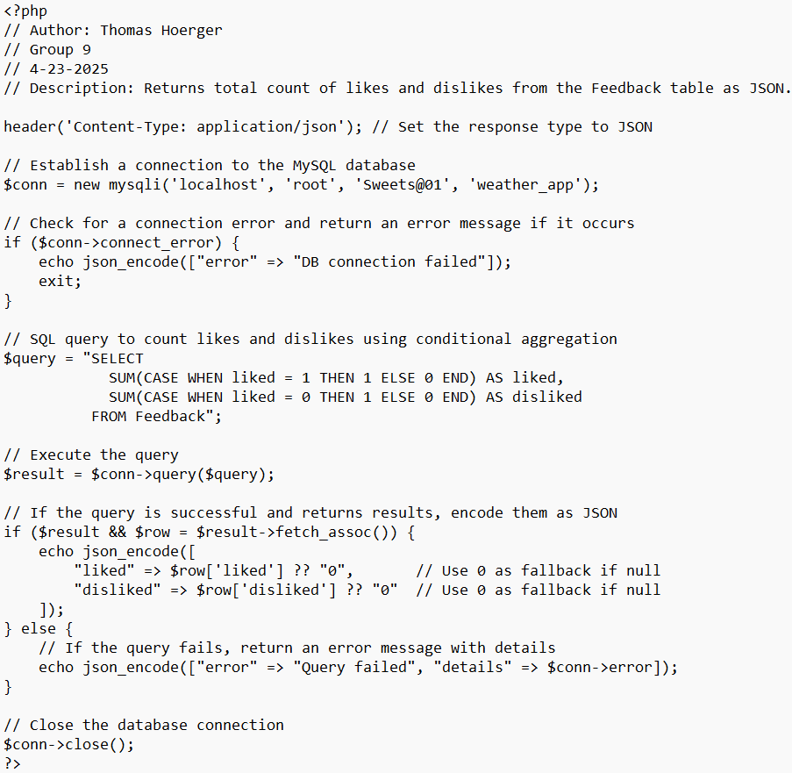
get_feedback_stats.php: Returns feedback data.

Slide 11
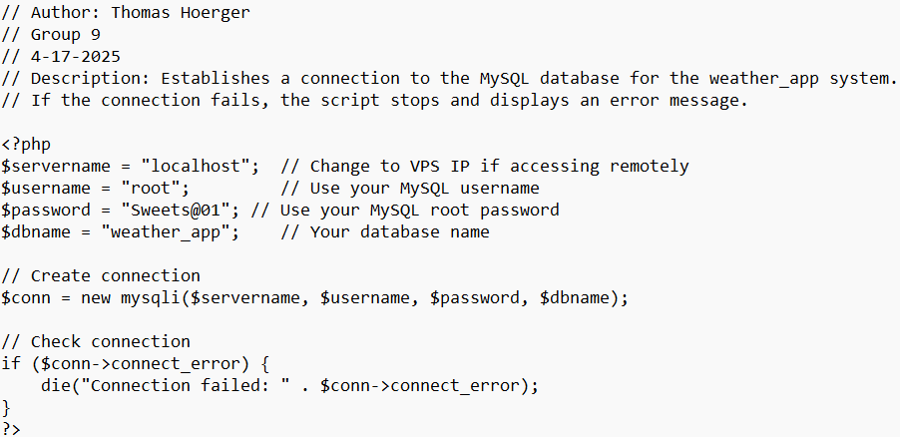
db_connect.php: Establishes connection to the database.

Slide 12
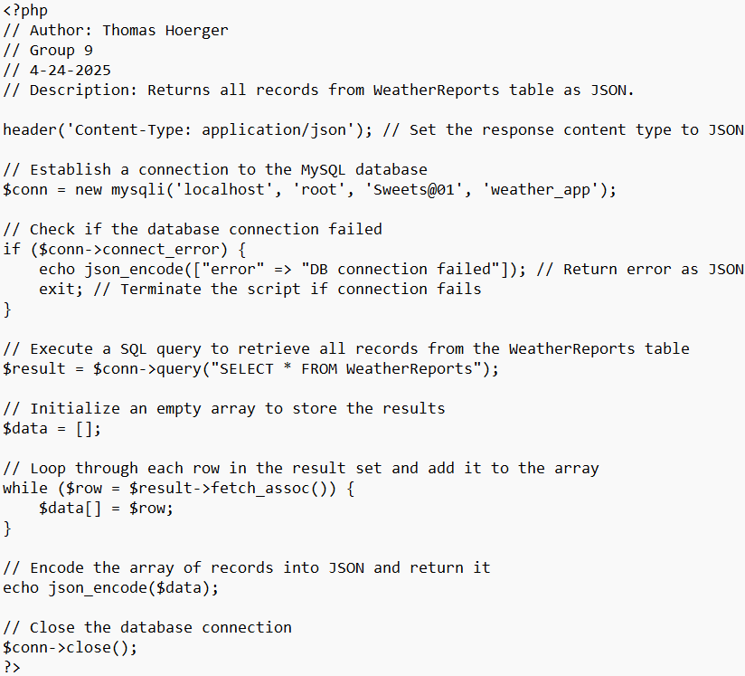
get_all_weather.php: Returns records from WeatherReports table.

Slide 13
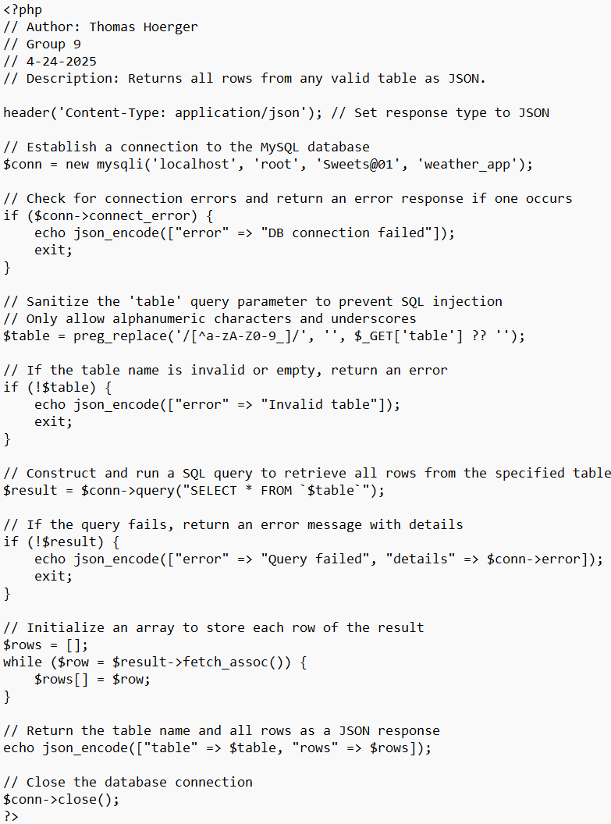
get_table_data.php: Returns table data from database.

Slide 14
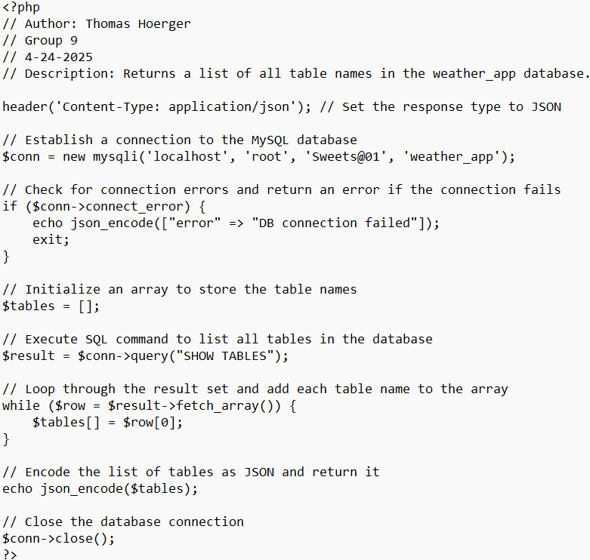
get_table_list.php: Returns table names from database.

Slide 15
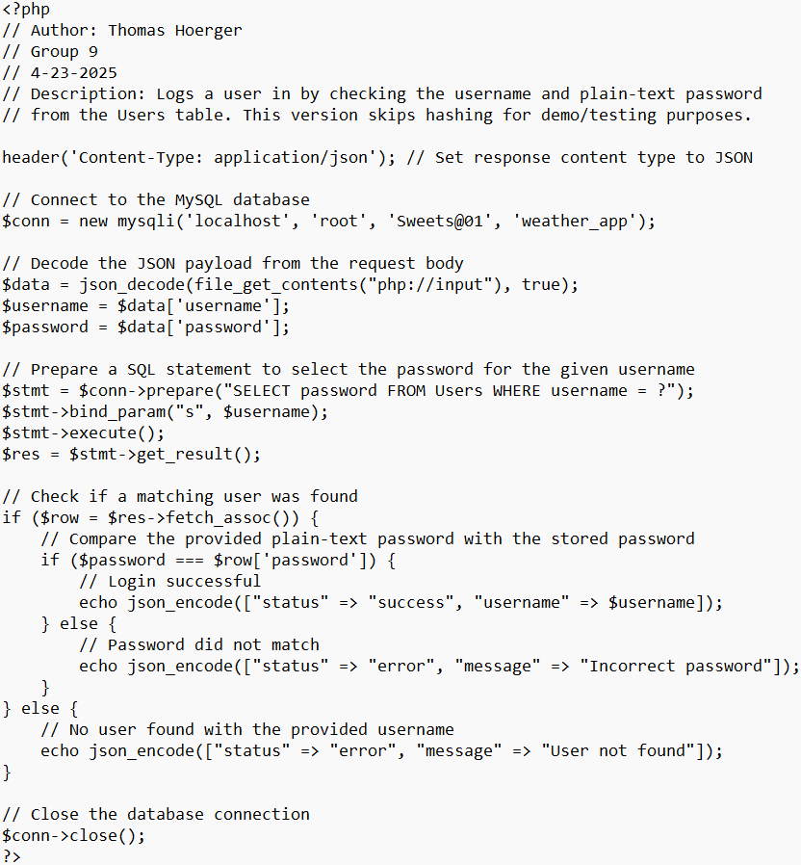
login_user.php: Logs user in by checking database.

Slide 16
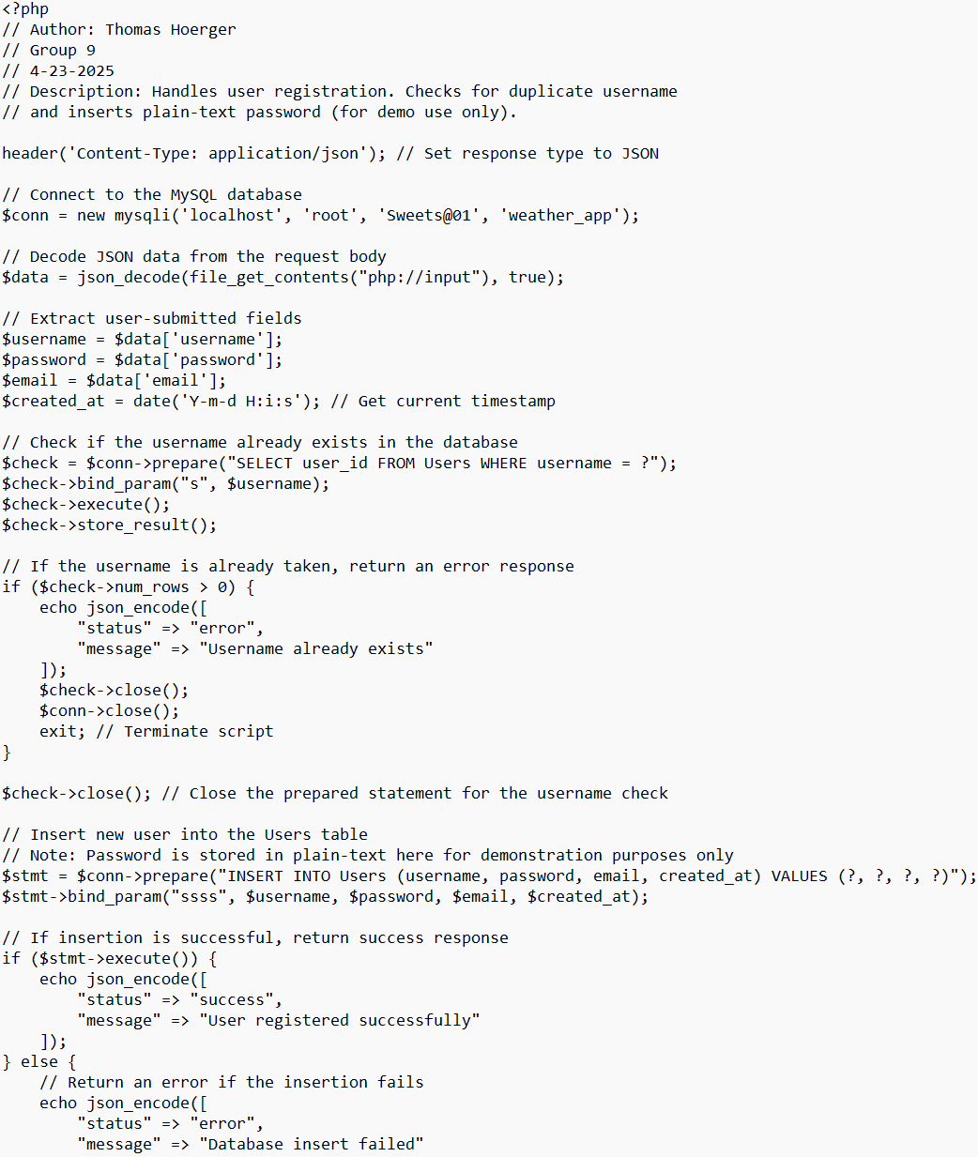
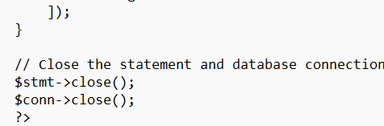
register_user.php: Handles user registration.

Slide 17
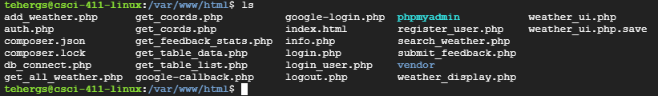
Show VPS Project Directory using ls

Slide 18
Step 5 Implemented 8 screens and 4 other JavaScript files in the Expo project on my local machine using JavaScript:

Slide 19
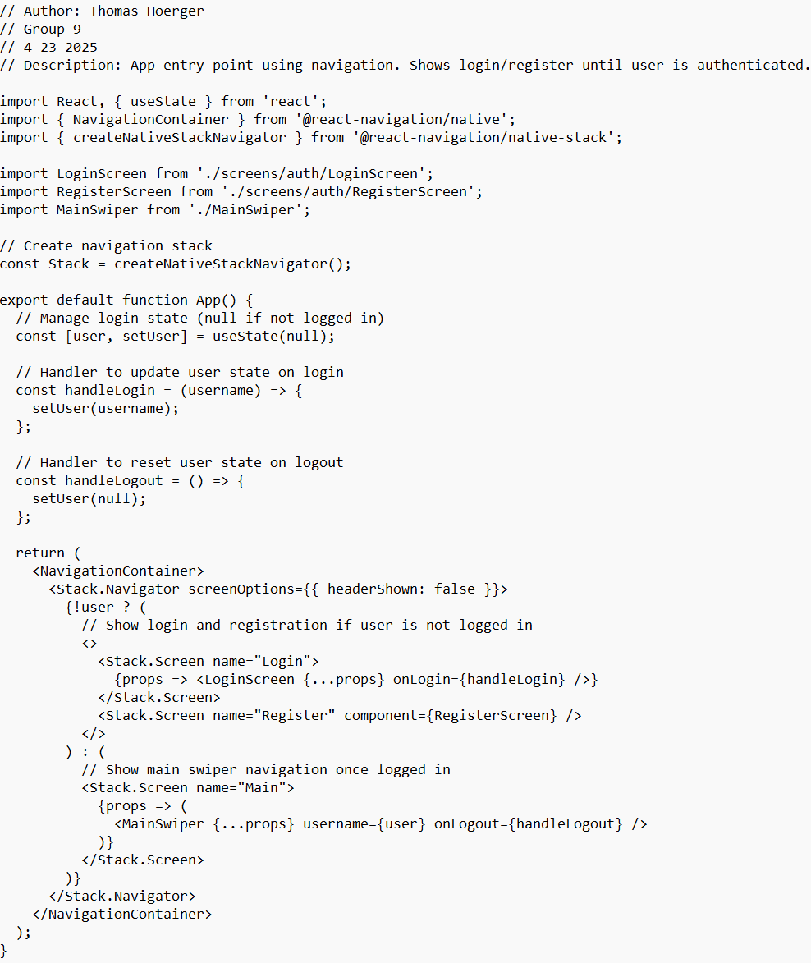
App.js: App entry point.

Slide 20
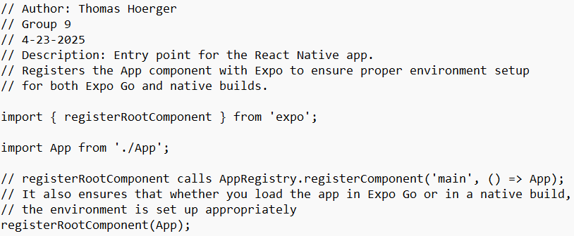
index.js: Registers app components.

Slide 21
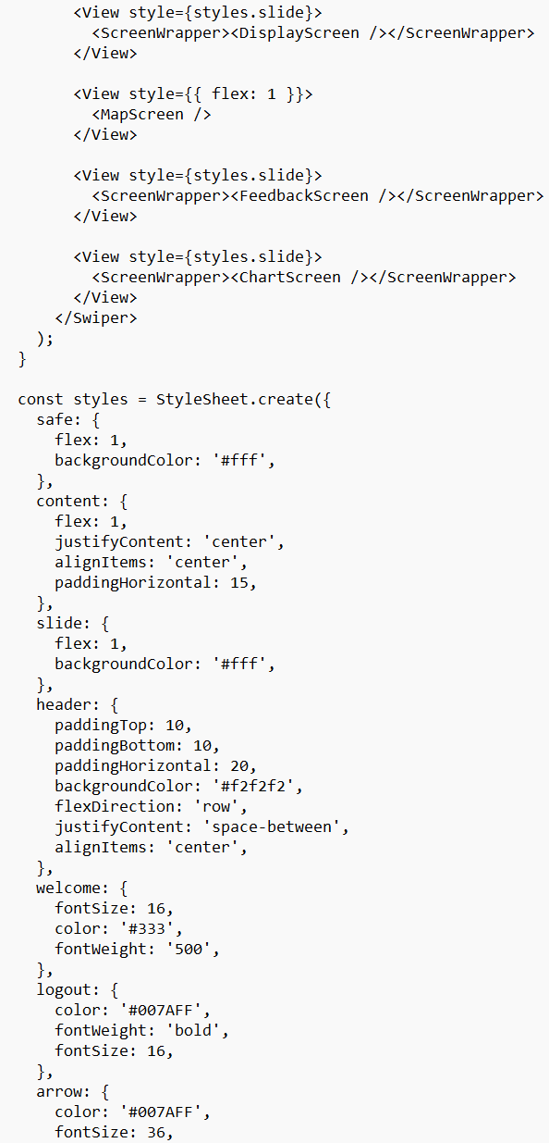
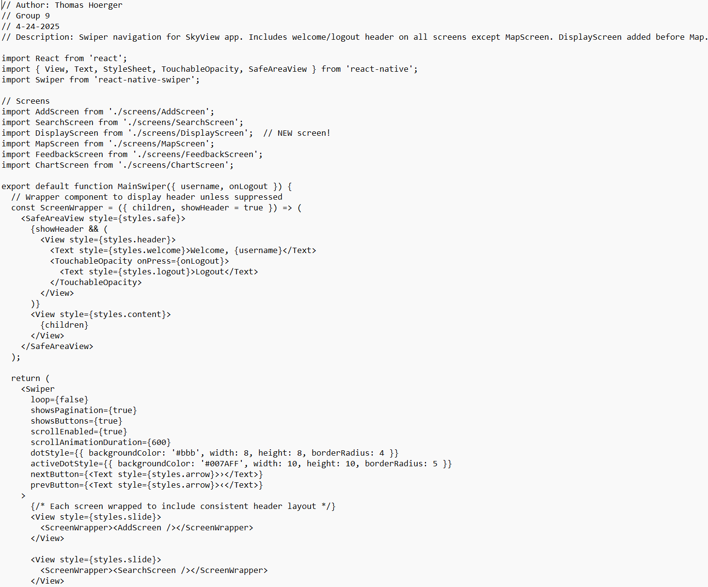
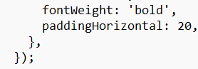
MainSwiper.js: Swiper navigation.

Slide 22
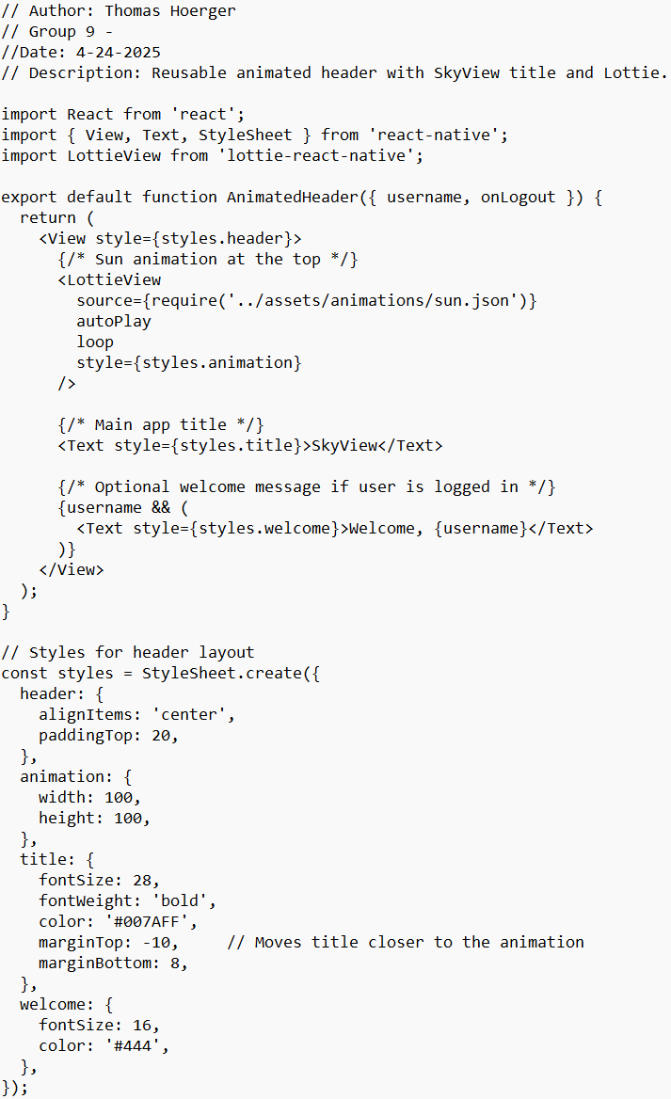
AnimatedHeader.js: Animated header for Lottie.

Slide 23
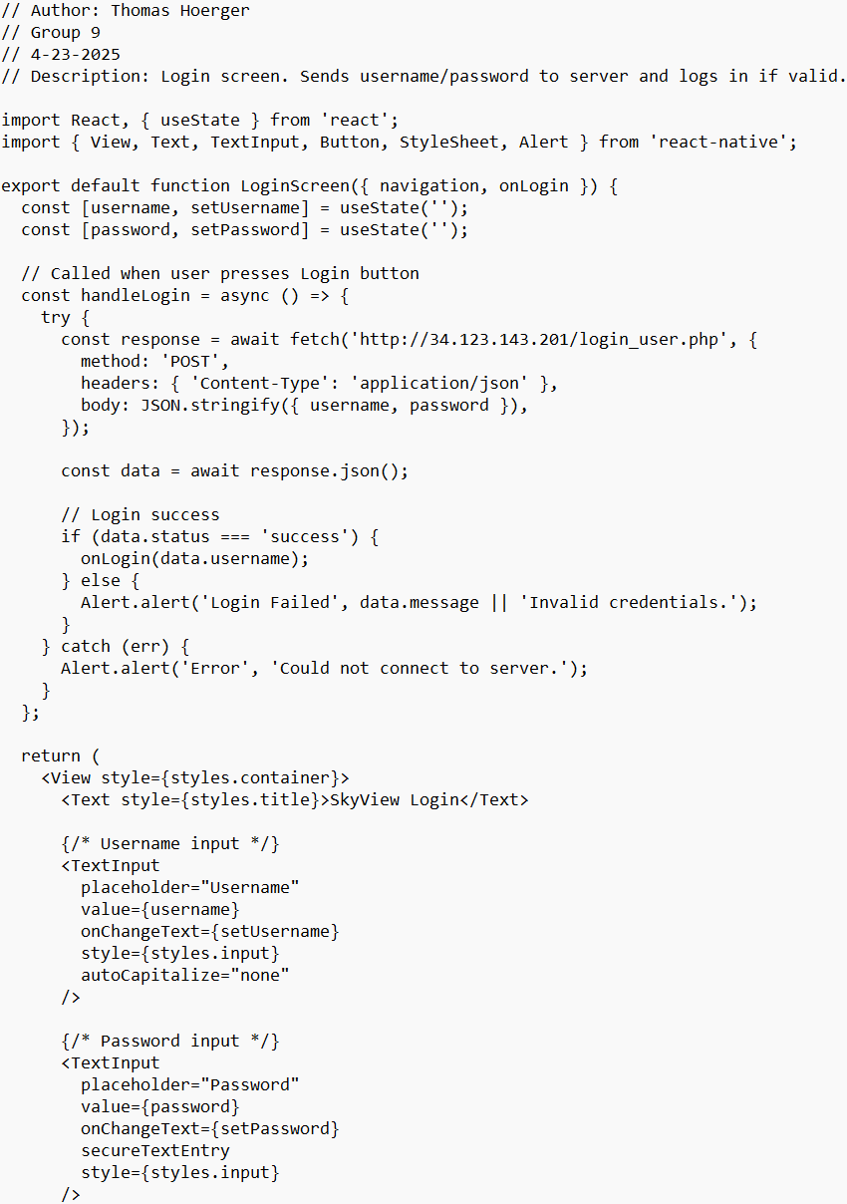
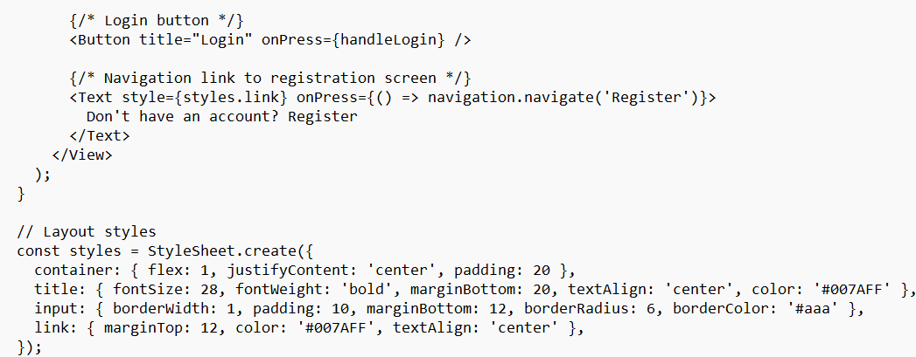
LoginScreen.js: Sends user and pass to server.

Slide 24
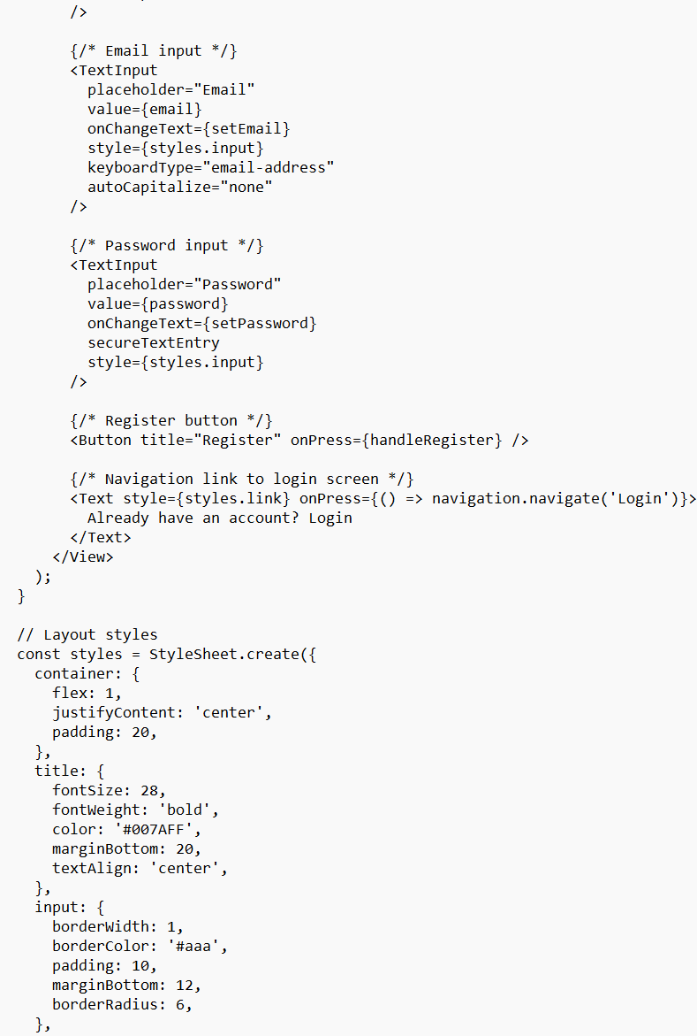
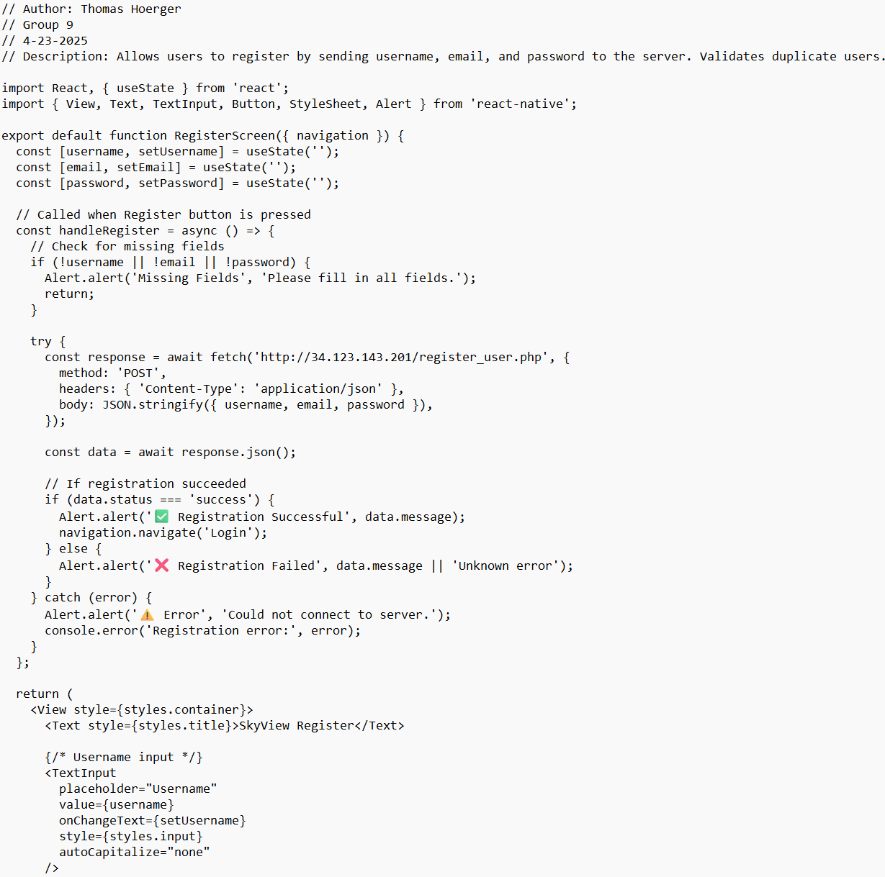
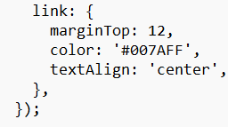
RegisterScreen.js: Allows registration.

Slide 25
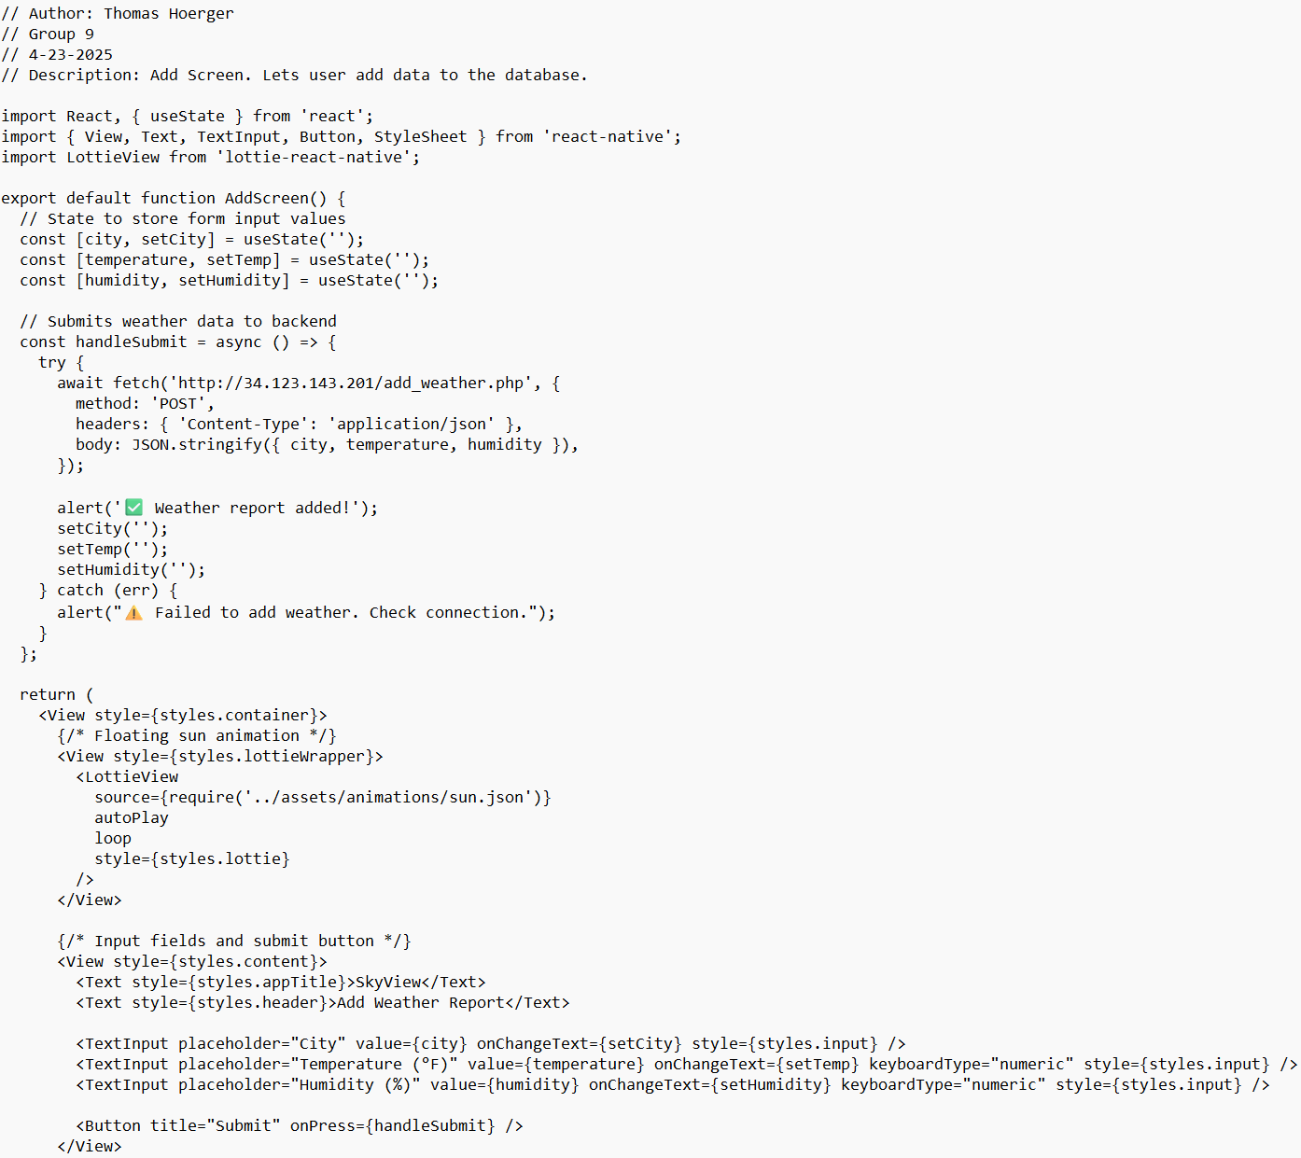
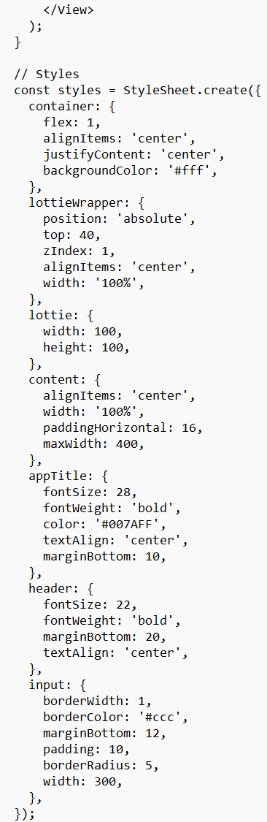
AddScreen.js: Form to submit weather.

Slide 26
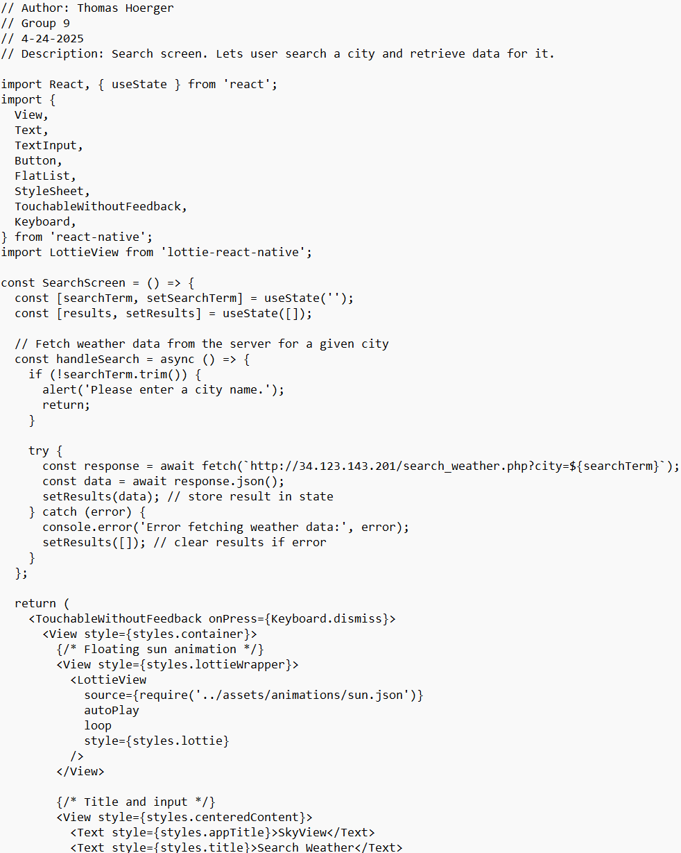
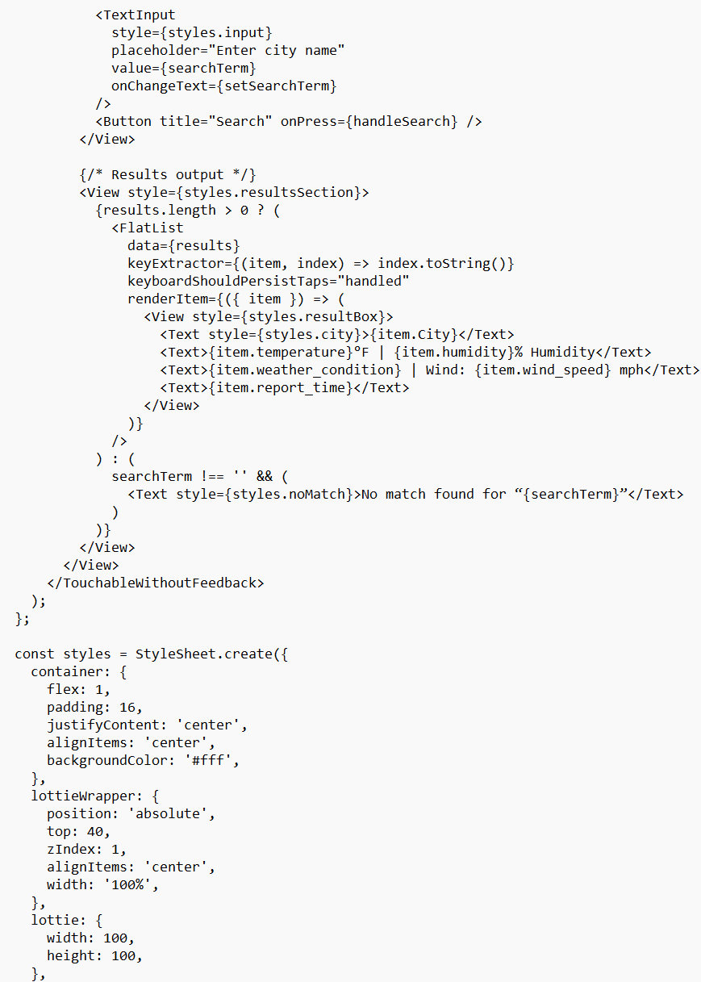
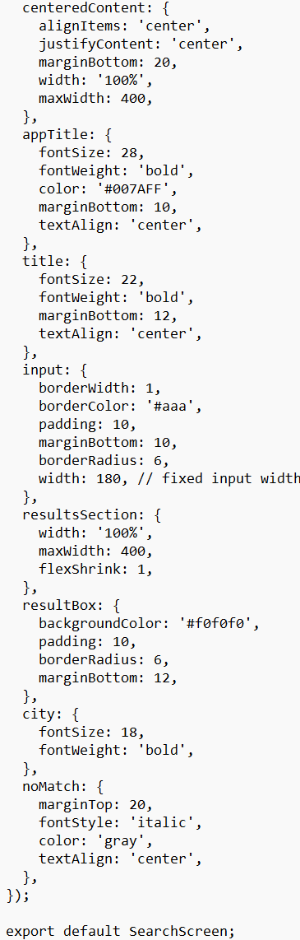
SearchScreen.js: Uses FlatList to show search results.

Slide 27
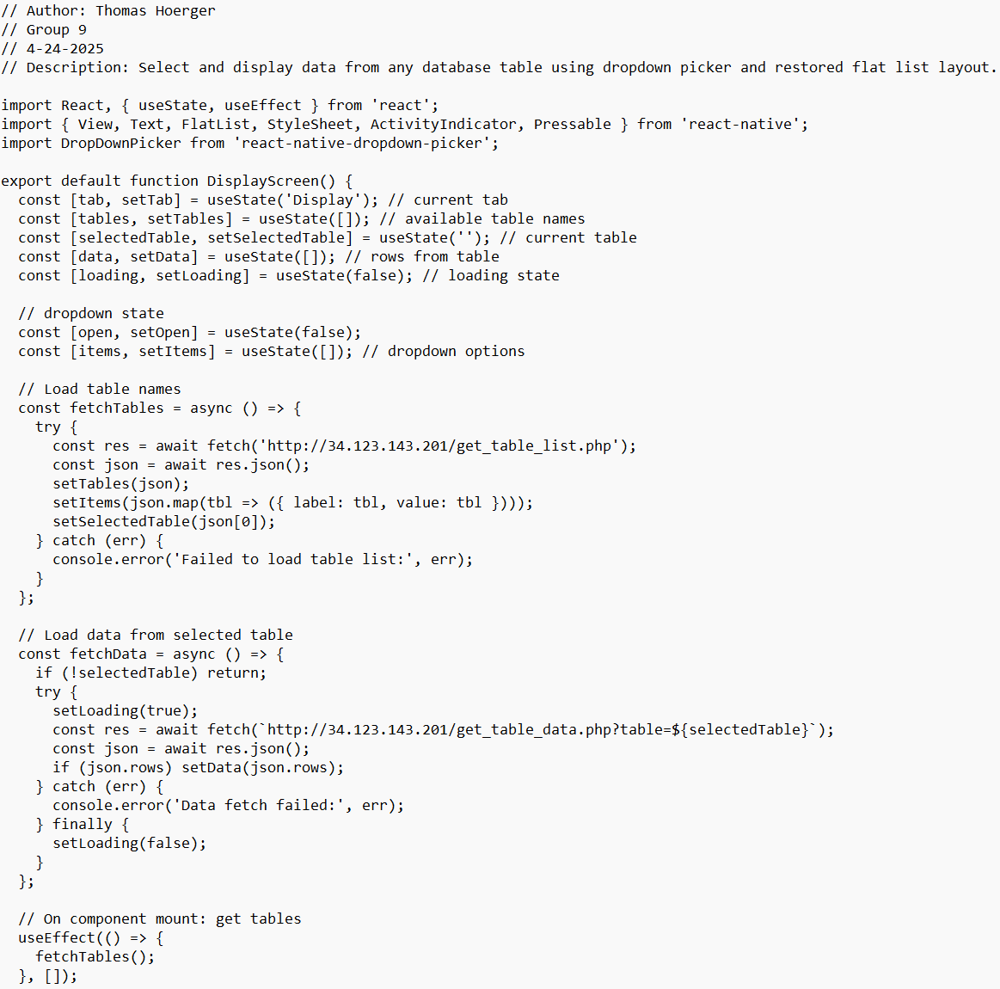
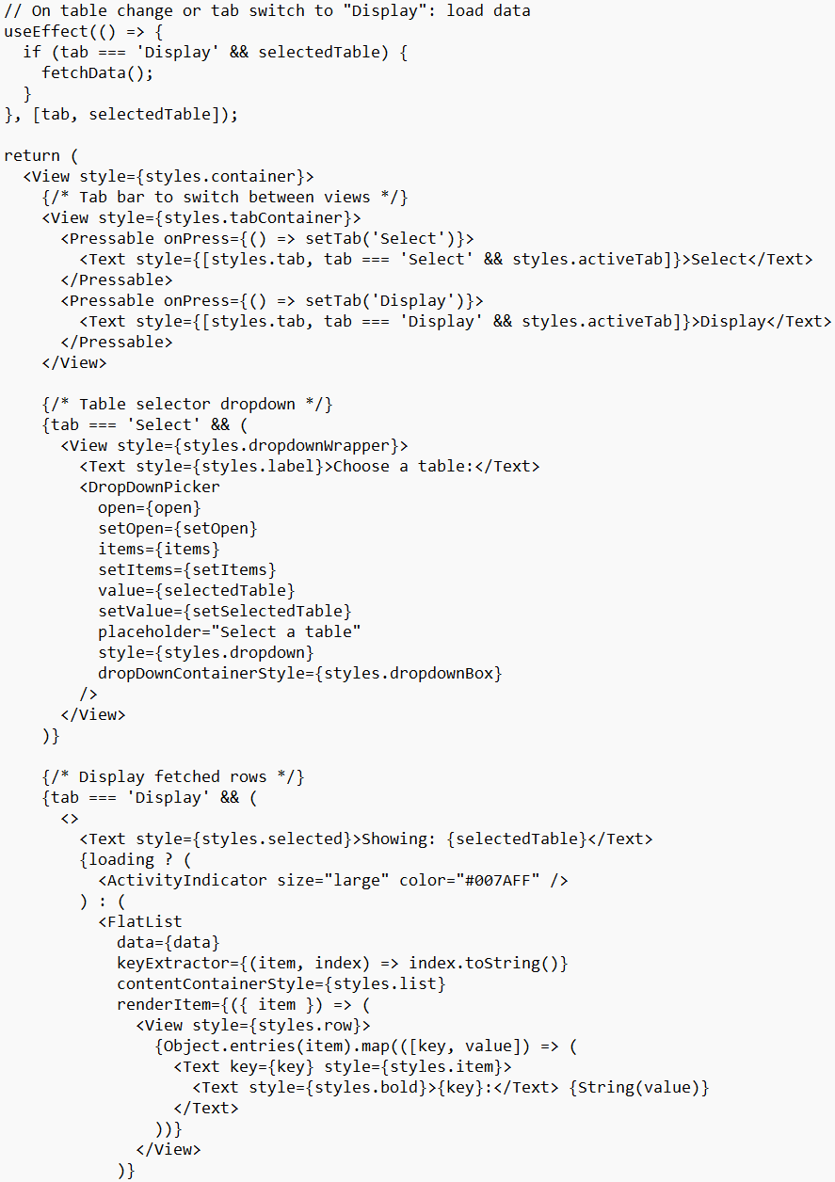
DisplayScreen.js: Select and display data from database.

Slide 28
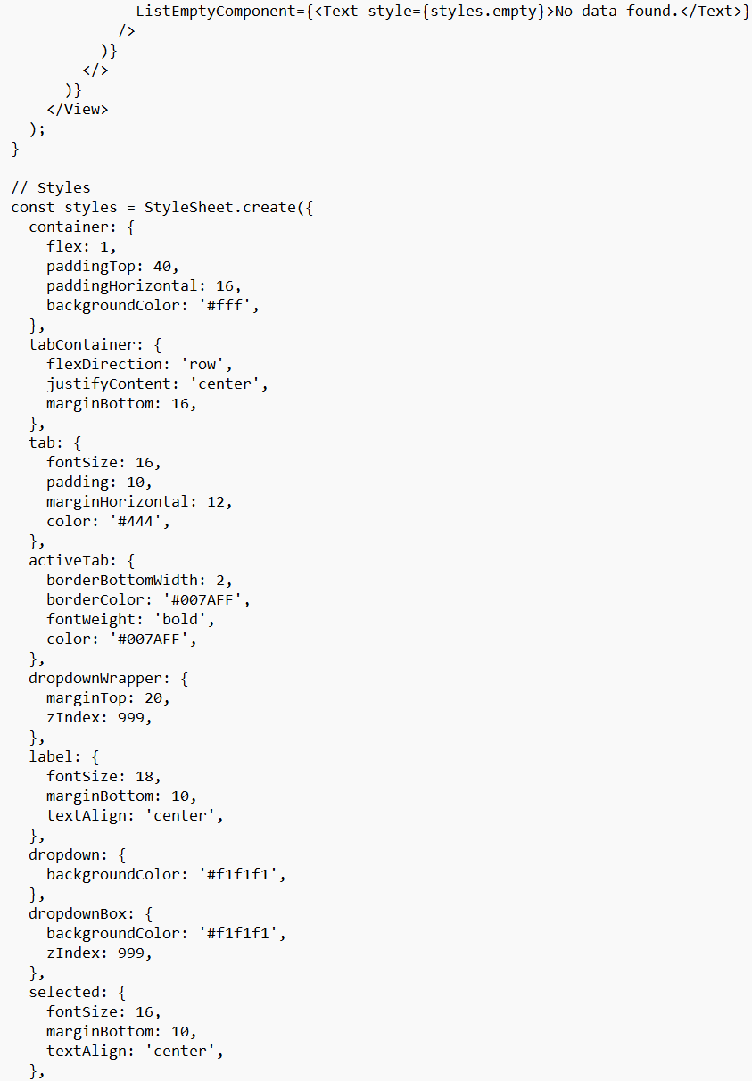
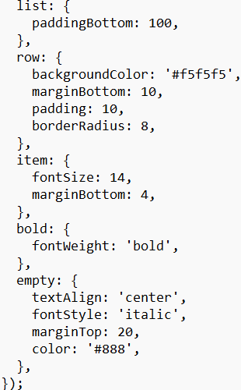
DisplayScreen.js Continued:

Slide 29
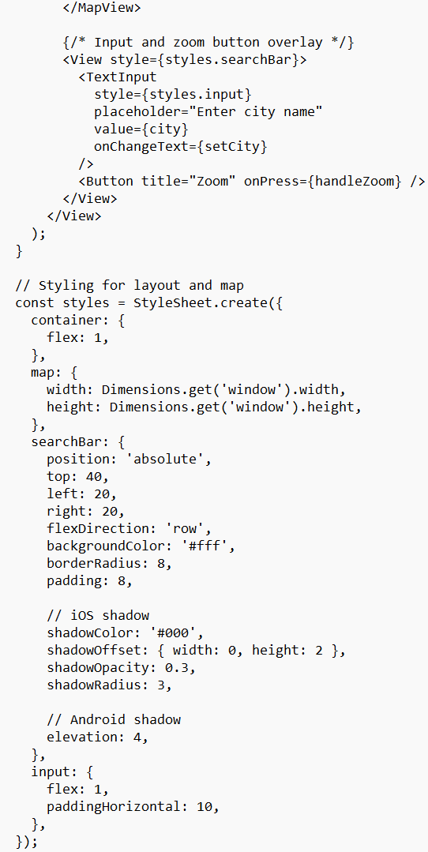
MapScreen.js: Zoom to coordinates using react-native-maps.

Slide 30
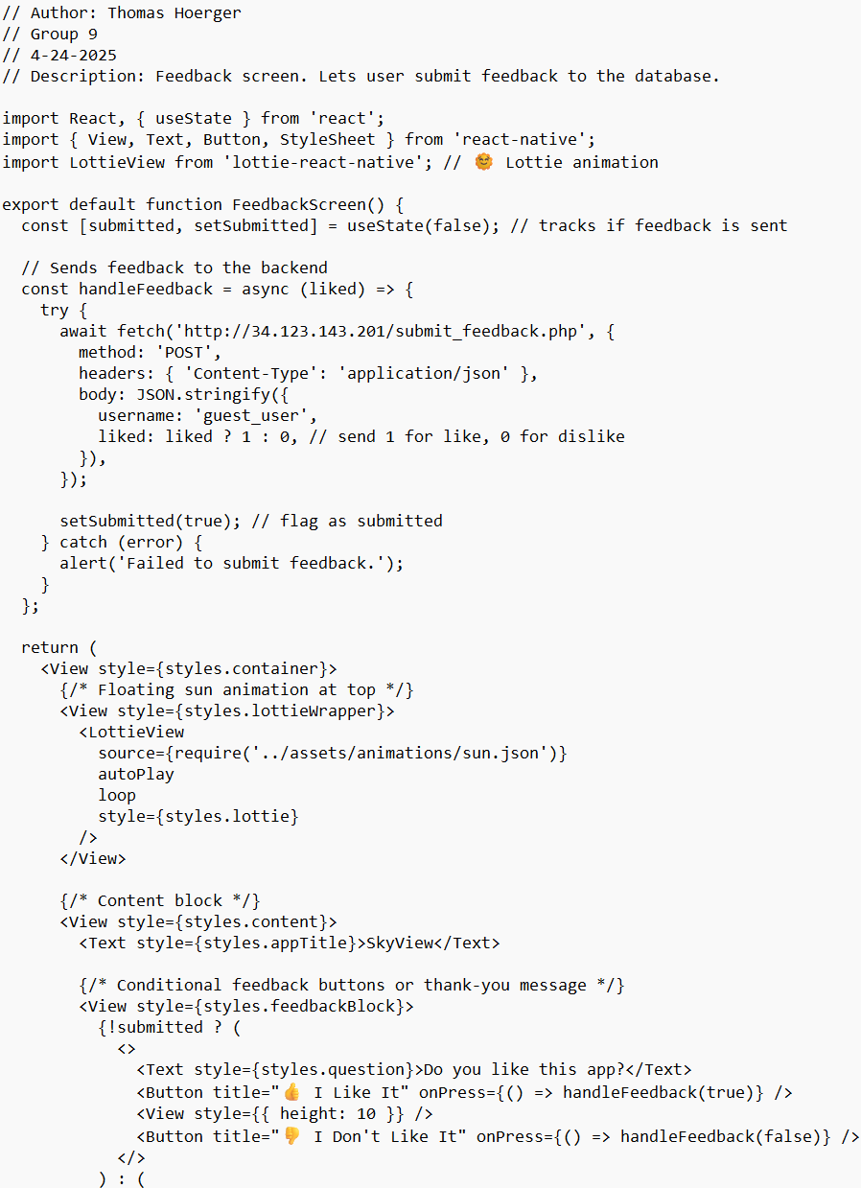
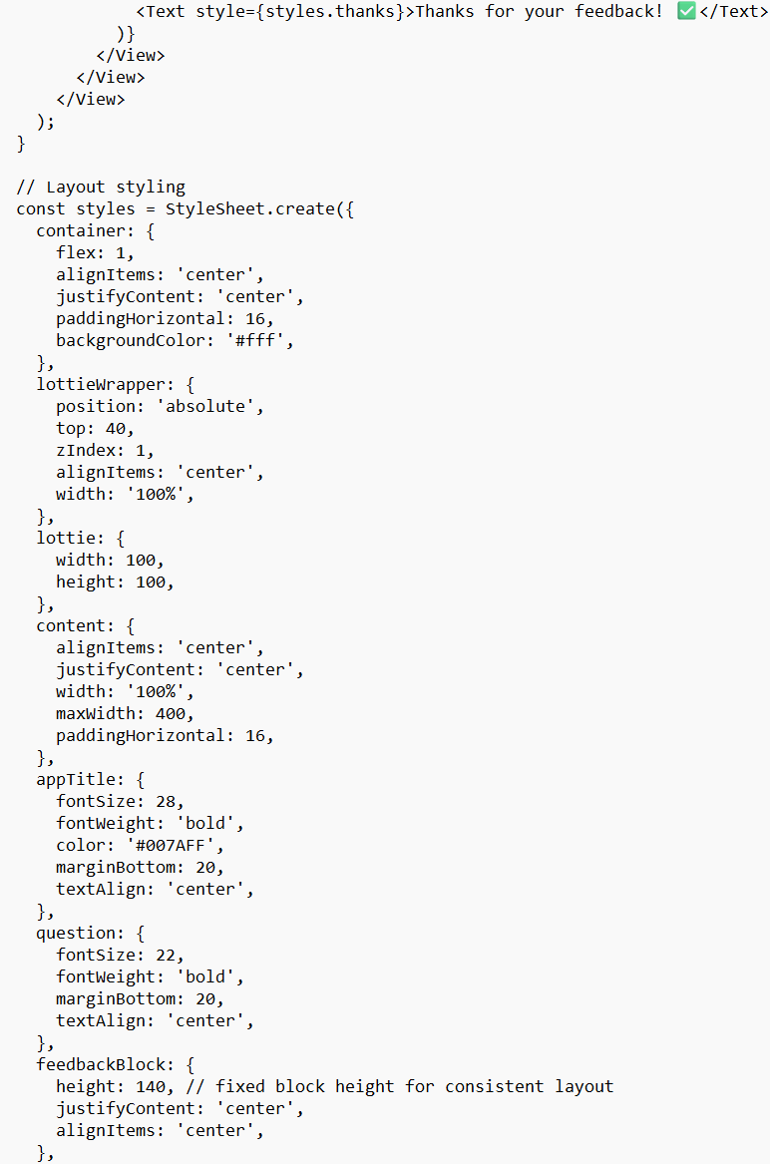
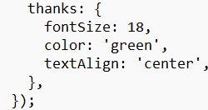
FeedbackScreen.js: Like/dislike UI and submits.

Slide 31
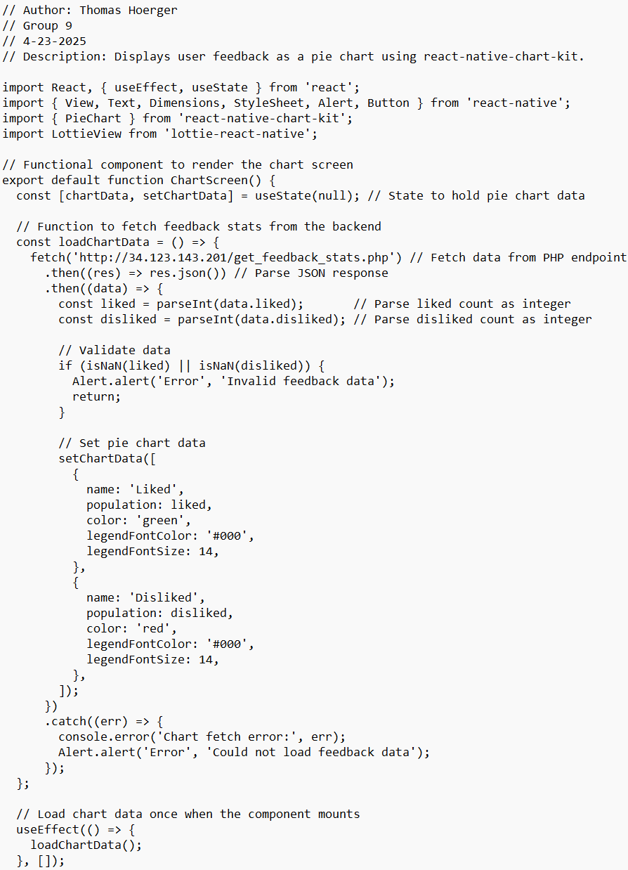
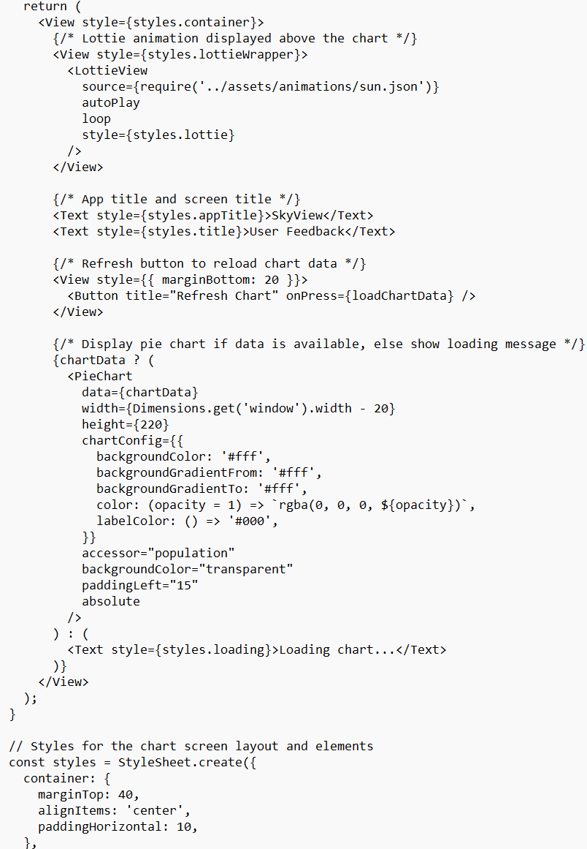
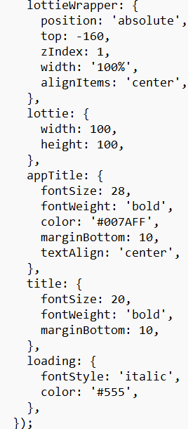
ChartScreen.js: Pie chart using react-native-chart-kit.

Slide 32
Included Features:
• Installed react-native-swiper for navigation.
• Added custom dot and arrow indicators.

Slide 33
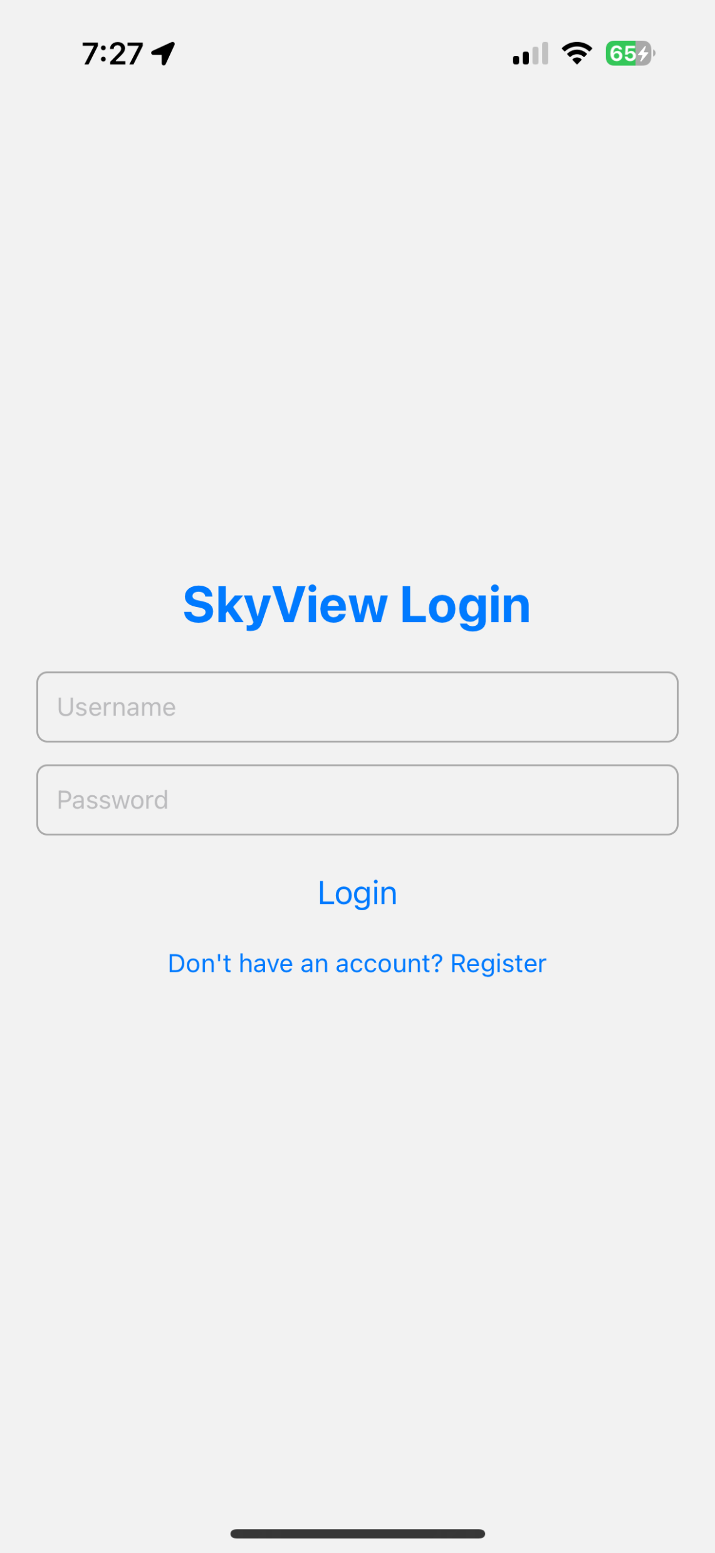
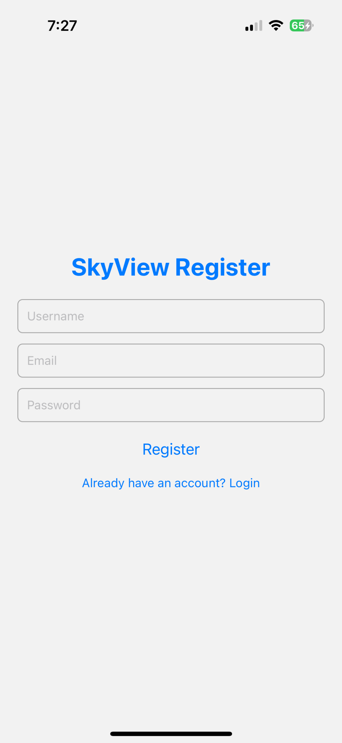
Included Features Continued:
Login/Register Screen

Slide 34
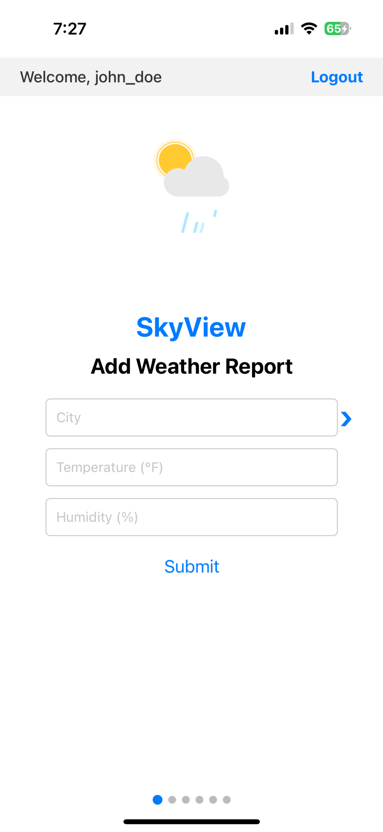
Included Features Continued:
• Implemented add feature so that the user can add to the database via the app.

Slide 35
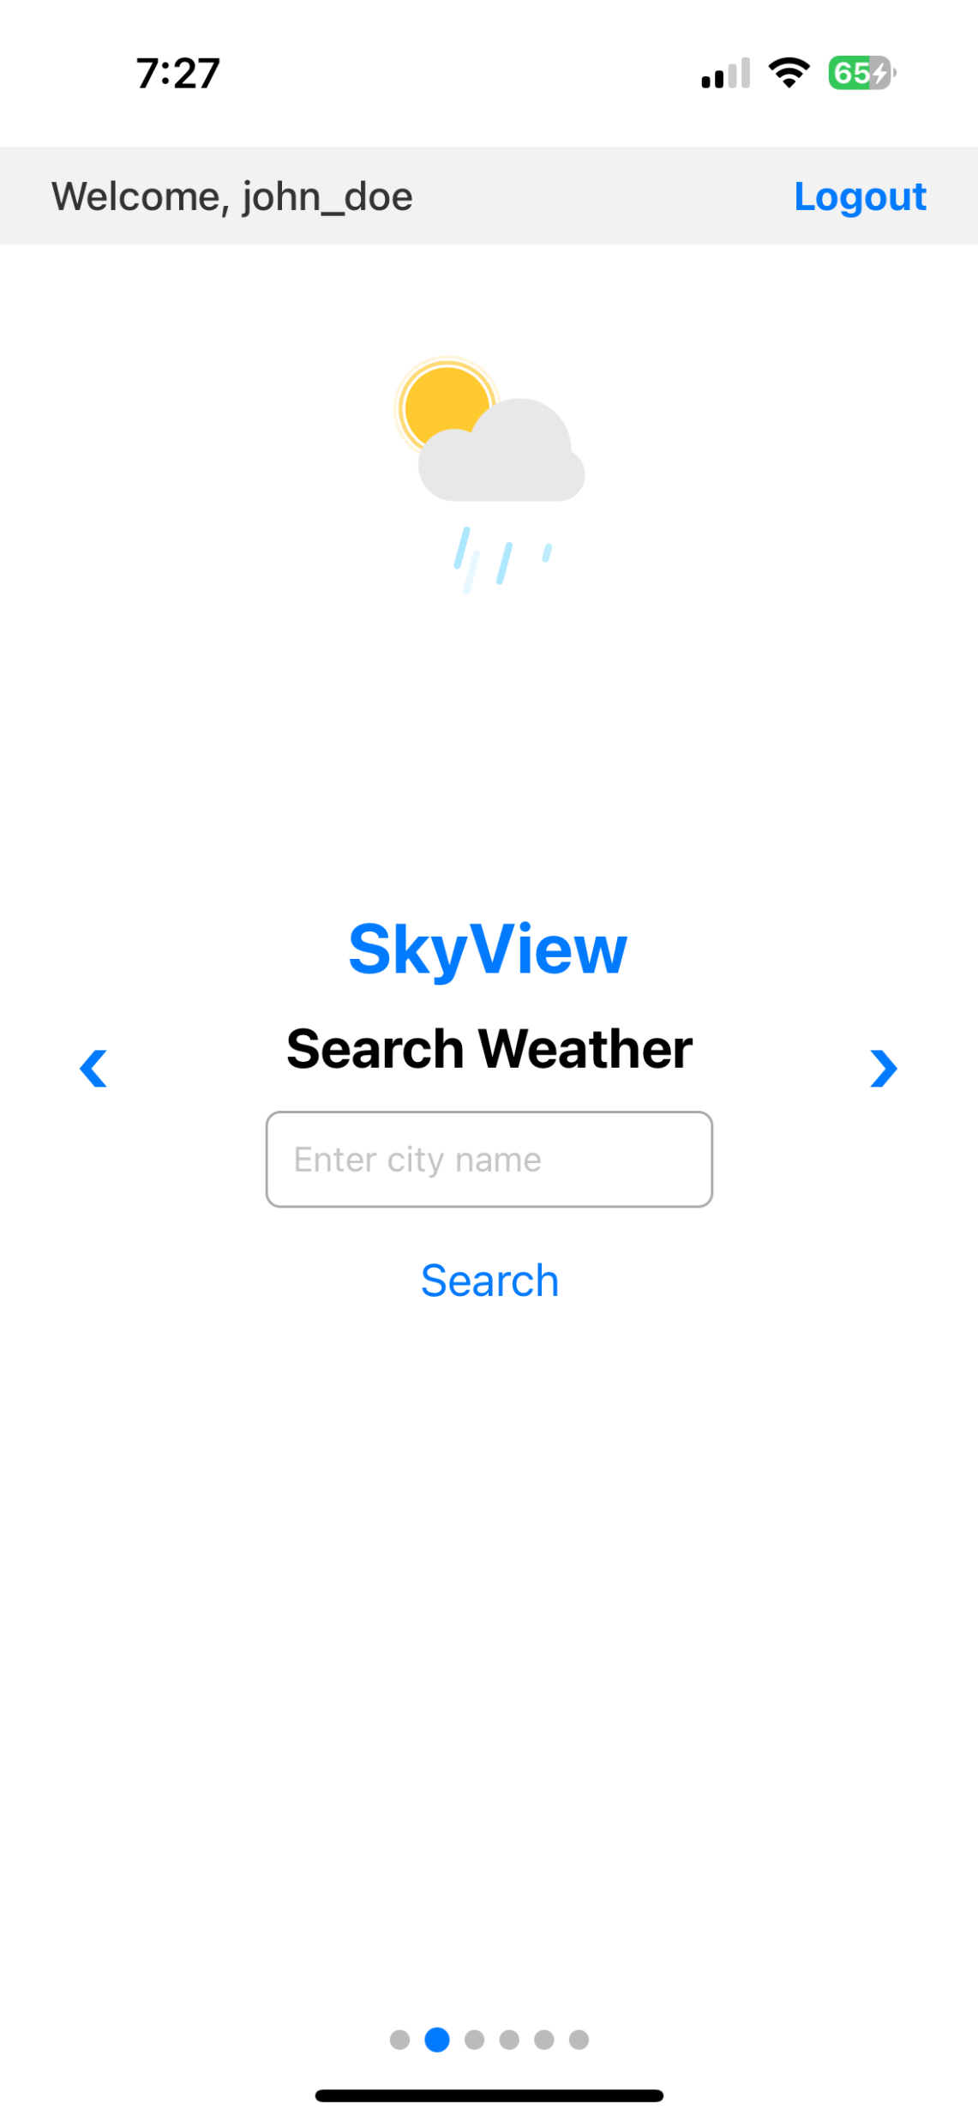
Included Features Continued:
• Added search so that the user can display weather reports from the searched city.

Slide 36
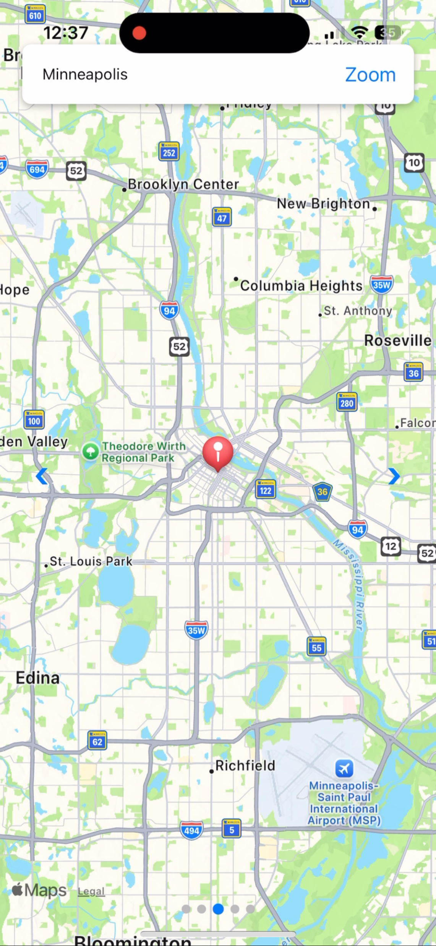

Included Features Continued:
• Added map feature so that the user can search a city and display it on a map.
• Integrated OpenWeatherMap API (Geo API) into get_coords.php. So, if the city isn’t in the database, script fetches coordinates live from API

Slide 37


Included Features Continued:
Feedback + Chart System
• Users select like/dislike and submit.
• Chart displays live data from database using a refresh button.

Slide 38


Included Features Continued:
Display Screen
• User can select which table from the database they would like and display it

Slide 39
Included Features Continued:
• Used responsive styles to support both mobile and laptop views.
• Components such as maps, charts, and form fields scale based on screen size.
• Added Lottie animation
• Added welcome (user) and logout button

Slide 40

Final Step: Install the Expo Go app and scan QR code to use app.

Slide 41
Summary:
In this project, I successfully designed and implemented a full-stack weather tracking application — SkyView — that is responsive, user-friendly, and powered by live data.
🌦️ Users can add and search weather reports for any city
🖥️ Display screen where users can select and display the database
🗺️ Interactive map view with dynamic geolocation support
📊 Feedback system with real-time pie chart visualization
📱 Fully functional across mobile and desktop platforms
🔐 Secure Login/Register – Users log in with credentials or register
The app is hosted on a live VPS and demonstrates real-time database integration, dynamic UI with React Native, and external API usage.
This project showcases my ability to combine design, frontend development, backend integration, and deployment into one cohesive and functional user-friendly app.

